Slide 1

Techloop+
Getting Started with Android Development

Slide 2
Android is a Java framework
Android is Open Source

Slide 3
IEEE VIT Student Chapter IEEEvit.com
Agenda
2
1
2
3
4
Episode 1
Episode 2
Episode 3
Episode 4
Getting Started
TextView
Buttons
Intents
ImageView
Callback Basics
OnClickListener
Splash Screen
RelativeLayout
LinearLayout
Fragments
Tabs
Listview
Spinner

Slide 4



IEEE VIT Student Chapter IEEEvit.com
UI Elements Used
5
Displays text to the user and optionally allows them to edit it.
TextView
Buttons
EditText
Represents a push-button widget. Push-buttons can be pressed, or clicked, by the user to perform an action.
EditText is a extension of TextView that configures itself to be editable.

Slide 5
Start a New Project
Start a new blank Android Studio
Project

Slide 6
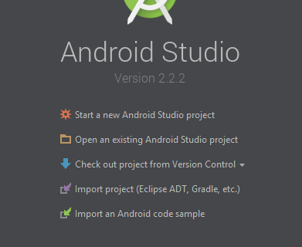
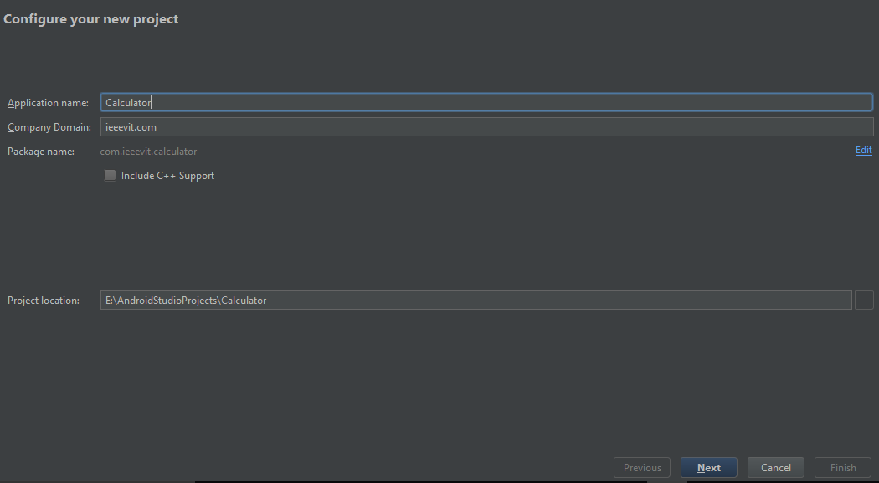
IEEE VIT Student Chapter IEEEvit.com
Start a new Android Project
7

Slide 7
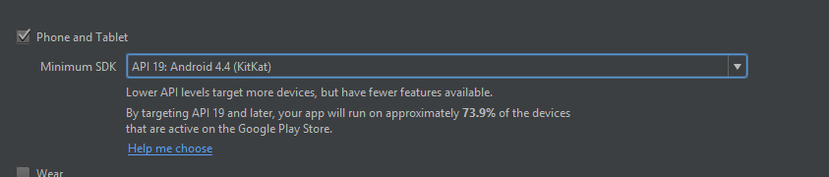
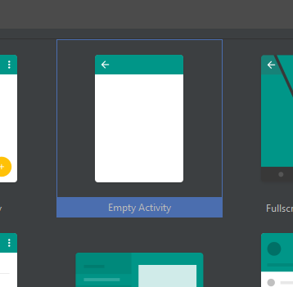
IEEE VIT Student Chapter IEEEvit.com
Start a new Android Project
8

Slide 8
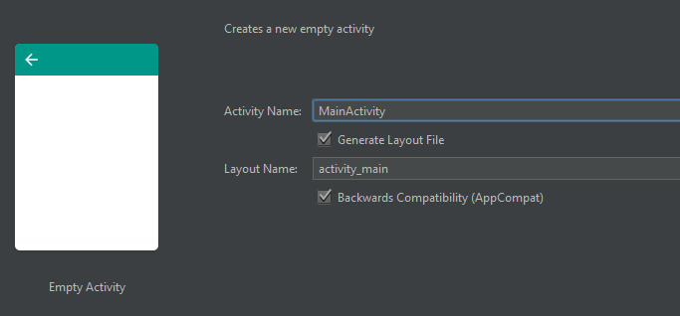
IEEE VIT Student Chapter IEEEvit.com
Start a new Android Project
9

